Slide 1
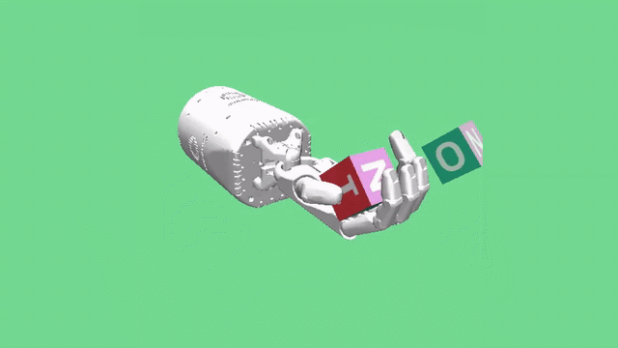
Random Agent:
Training a Robotic Hand in Object Orientation Tasks
A research by: Amir Pliev, Raphael Fortunato, Mike Nies and Julio Goodsaid

Slide 2
Epoch: 03
Content
Reinforcement Learning
Deep Deterministic Policy Gradient
Hindsight and Prioritized Experience Replay
Results
Conclusion

Slide 3
Epoch: 06
OpenAI Gym
Reinforcement learning playground
Provides multiple environments to train agents
Agents can (most of the times) be transferred to other similar environments

Slide 4
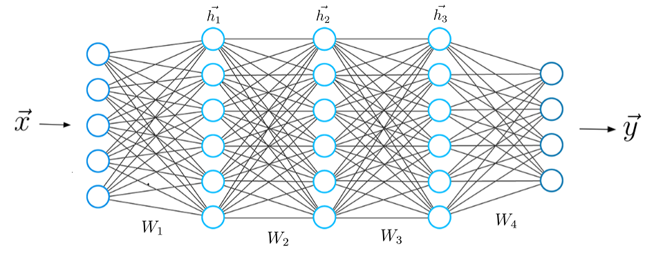

Epoch: 09
Deep Reinforcement Learning
Positive and negative reinforcement
Exploration happens through randomness
Uses Neural Network as function approximator

Slide 5
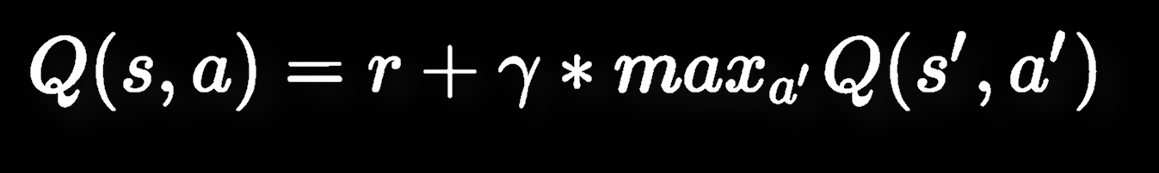
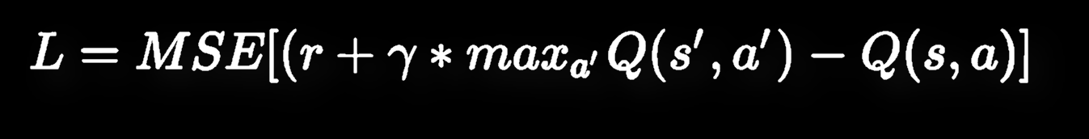
Epoch: 12
Bellman Equation
Agent improves by minimizing the MSE loss of the bellman equation

Slide 6
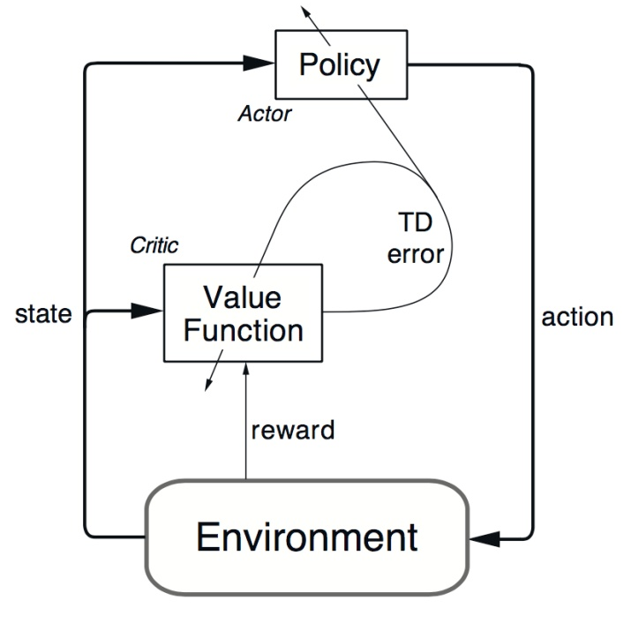
Epoch: 15
DDPG
Actor and Critic cooperation
Select the best action to perform in a given state
The critic network is tasked with finding the proper Q-value for a given state action pair.

Slide 7
Epoch: 18
HER and PER
Hindsight Experience Replay (HER)
Achieved goal becomes actual goal
Future-k variation
Learning from negative experiences
Prioritized Experience Replay (PER)
Prioritize “important” experiences
Hopefully also speeds up the learning process
Our variation:
Focus on Distance metric
Focus on Impact metric
70% in sample is ‘important’

Slide 8
Epoch: 20
Parameters
Network layers
3 layers with 256 units and ReLU
Epochs = 90
Future-k = 4
Probability of HER = 0,8
Distribution of PER = 0,7

Slide 9
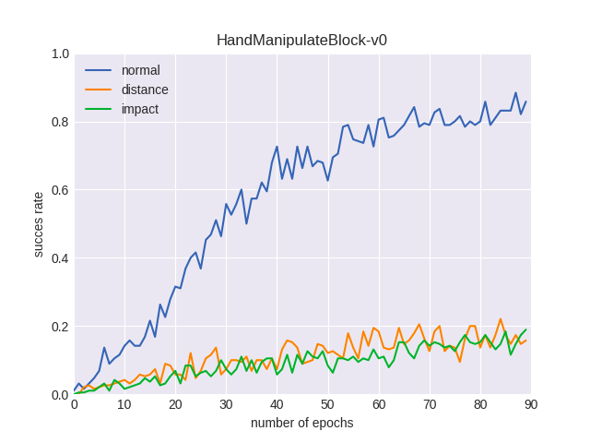
Final demo:
Results
Final demo
Normal HER outperformed our version of PER

Slide 10
Timelapse
Conclusion
A Deep deterministic Policy Gradient consist of 2 networks, an Actor and a Critic
The actors job is to select the best action in an given state
The critic network is tasked with finding the proper Q-value for a given state action pair.

Slide 11
Questions?
Timelapse

